Slide 1
Digital Portfolio
STUDENT NAME: Jeevesh K
REGISTER NO AND NMID: 222407867 &1028BE02724338FA3F7438FB6A0F4957
DEPARTMENT: Bsc. Computer science with Data science
COLLEGE:Tagore college of arts & science /Madras university

Slide 2
PROJECT TITLE
Digital Resume & Portfolio – Jeevesh K

Slide 3


AGENDA
Problem Statement
Project Overview
End Users
Tools and Technologies
Portfolio design and Layout
Features and Functionality
Results and Screenshots
Conclusion
Github Link
3/21/2024 Annual Review

Slide 4

PROBLEM STATEMENT
Freshers often struggle to showcase their skills and projects effectively.
Resumes are static and fail to highlight hands-on experience.
Need for a digital, interactive portfolio to present education, skills, and achievements.

Slide 5

PROJECT OVERVIEW
Developed a personal portfolio website for presenting academic background, technical skills, and selected projects.
Focused on accessibility, interactivity, and responsive design.
Acts as a digital resume + showcase platform.

Slide 6

WHO ARE THE END USERS?
Recruiters and hiring managers.
College faculty and evaluators.
Potential collaborators or mentors.
Peers and fellow students for knowledge exchange.

Slide 7

TOOLS AND TECHNIQUES
Frontend: HTML5, CSS3, JavaScript
Frameworks/Libraries: React.js (expandable), Node.js (optional)
Styling: Google Fonts, responsive design, animations
Version Control: Git & GitHub
Others: Cloud basics (AWS/GCP) for deployment

Slide 8
POTFOLIO DESIGN AND LAYOUT
Clean, modern design with gradient text headings and vibrant colors.
Fixed navigation bar with smooth scrolling.
Sections: Home, Education, Skills, Projects, Contact.
Responsive layout optimized for mobile and desktop.
8

Slide 9
FEATURES AND FUNCTIONALITY
Interactive skill chips and project cards with hover animations.
Profile photo with zoom effect on hover.
Contact section with click-to-call and email links.
Accessibility: ARIA labels, keyboard navigation (tabindex).
Lightweight, fast-loading, and user-friendly.

Slide 10
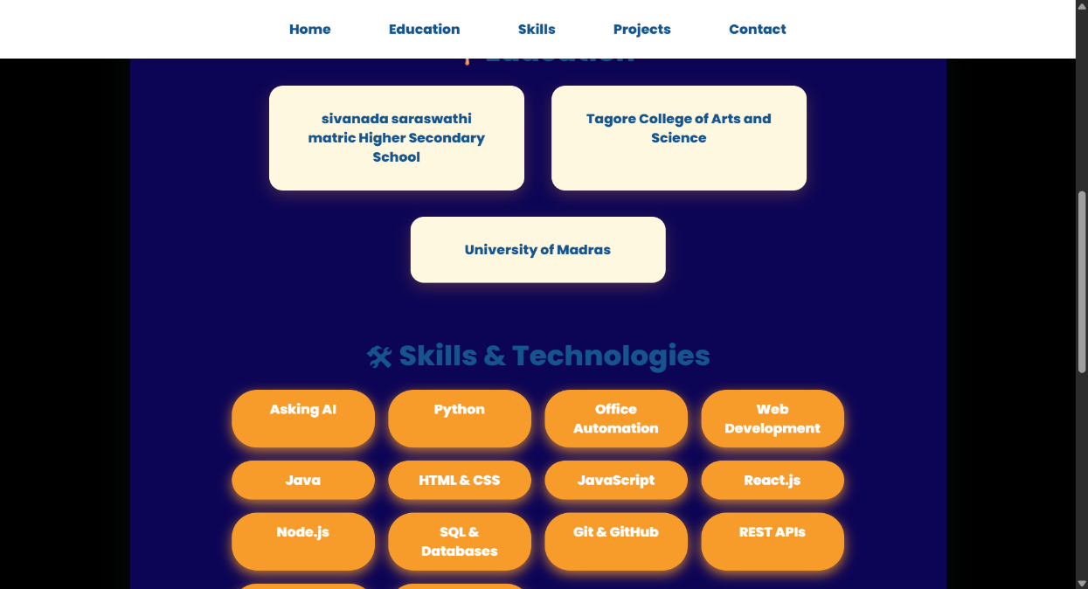
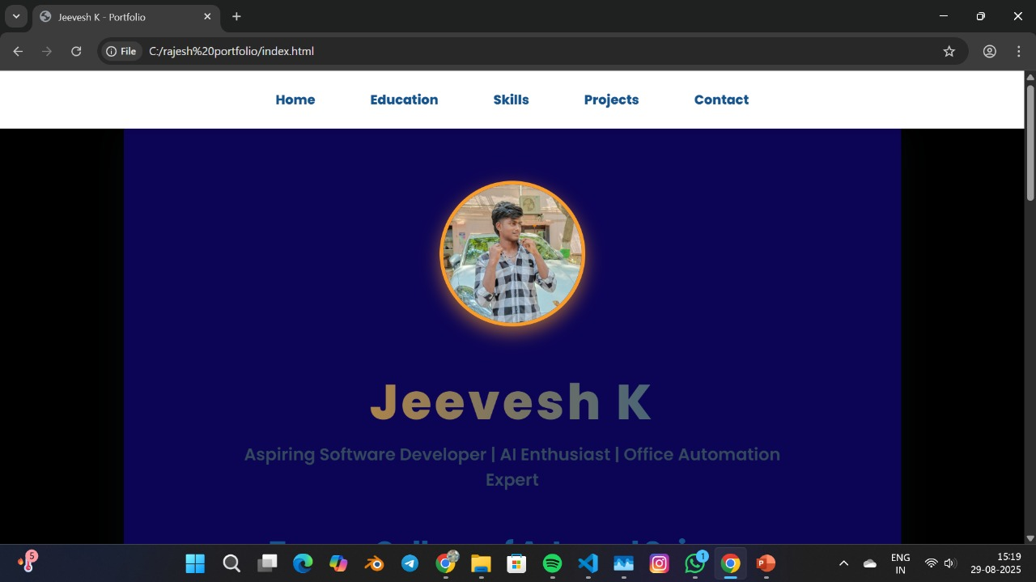
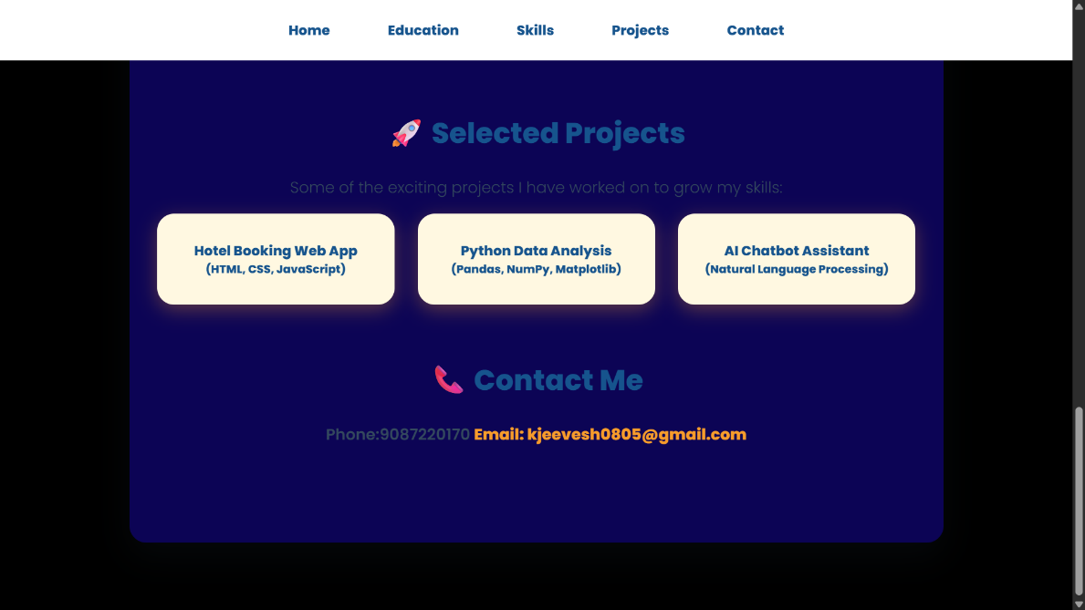
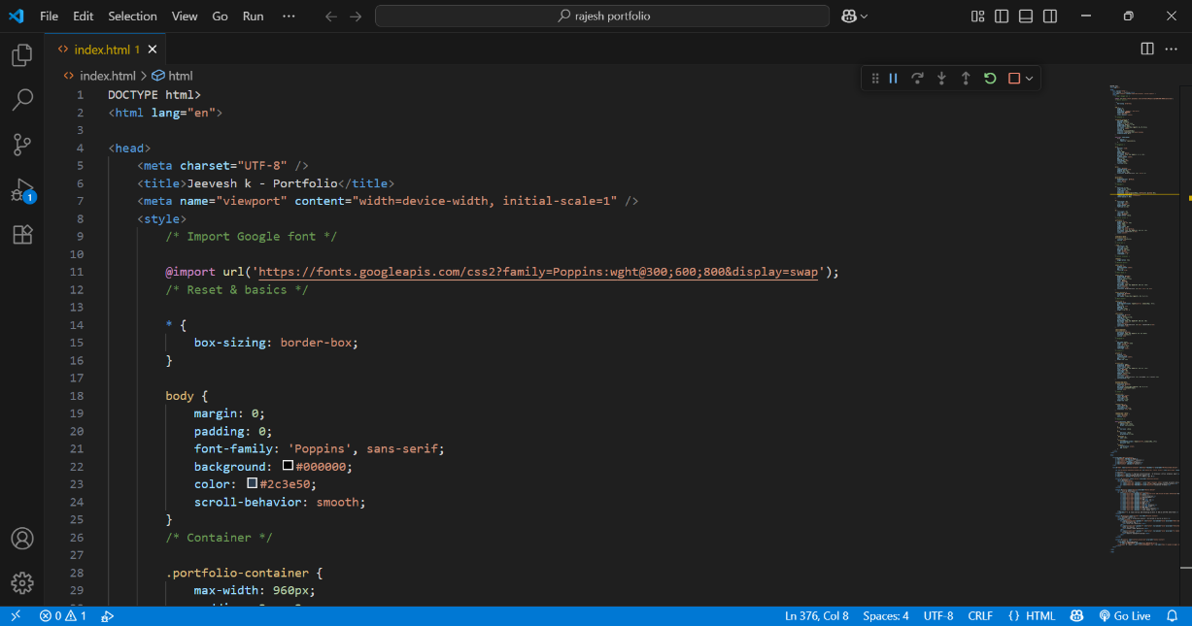
RESULTS AND SCREENSHOTS
3/21/2024 Annual Review
10

Slide 11
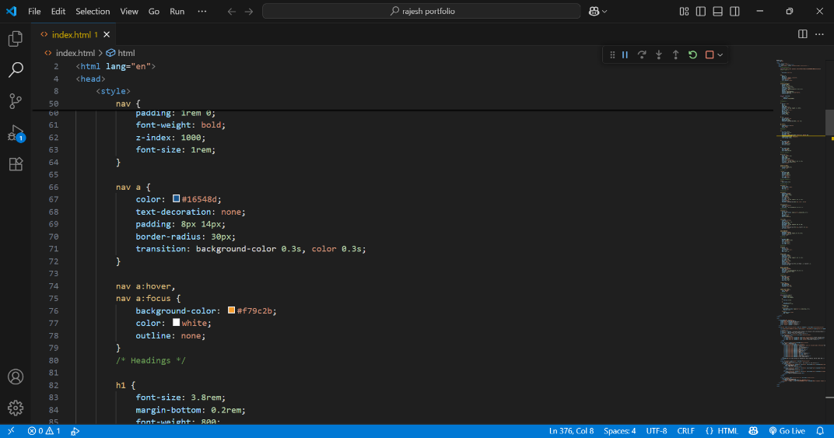

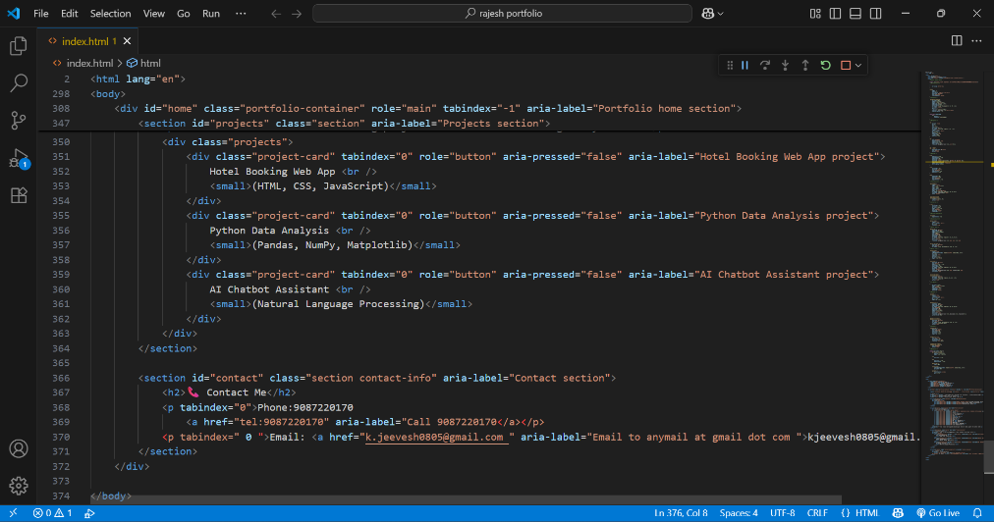
RESULTS AND SCREENSHOTS

Slide 12
CONCLUSION
CONCLUSION
Digital portfolio is more effective than a static resume.
Provides recruiters with quick access to skills and projects.
Enhances personal branding and career opportunities.
Future scope: add blog, integrate AI chatbot, and host on cloud platforms.
12
12

Slide 13
GITHUB LINK
https://github.com/Jeevesh0805/Jeeveshpotfolio.git

